Slide 1
Brain MRI Images for Brain Tumor Detection
Andrew Willy

Slide 2
TABLE OF CONTENTS
Business background
Eda and pre-processing
modelling
conclusion

Slide 3
Business background
We are a Data Scientis Trying to help hospital to classify if a tumor in a brain is detected.

Slide 4
Business Objectives
The objectives is trying to predict if there are a tumor inside a human brain.

Slide 5
Expected Output
The output is either the brain has a tumor or not.

Slide 6
Project Limitation
We got little time
The data is not much

Slide 7
Analytic Approach
Convolutional neural network
Metric : accuracy

Slide 8
Eda and Preprocessing

Slide 9
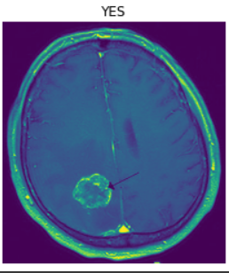
Data
https://www.kaggle.com/navoneel/brain-mri-images-for-brain-tumor-detection
155 images of brain tumor and 98 images of normal brain.
I split the data into 3 categories train, validation and test.
193 Images for Training, 50 images for validation, and 10 for unseen data.

Slide 10
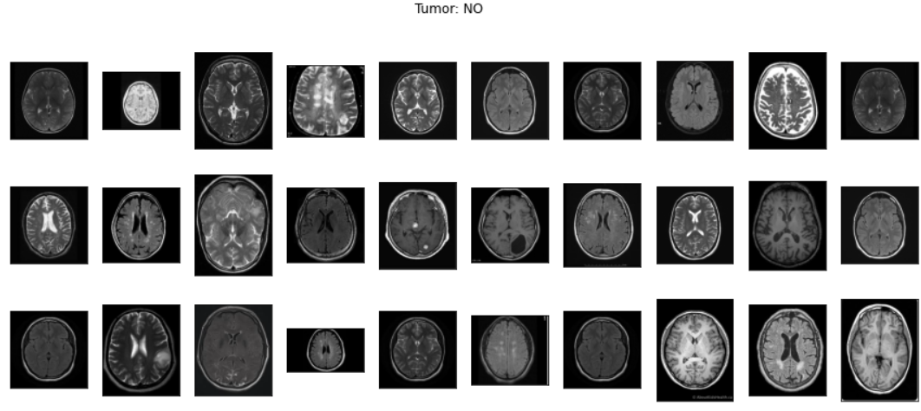

Slide 11
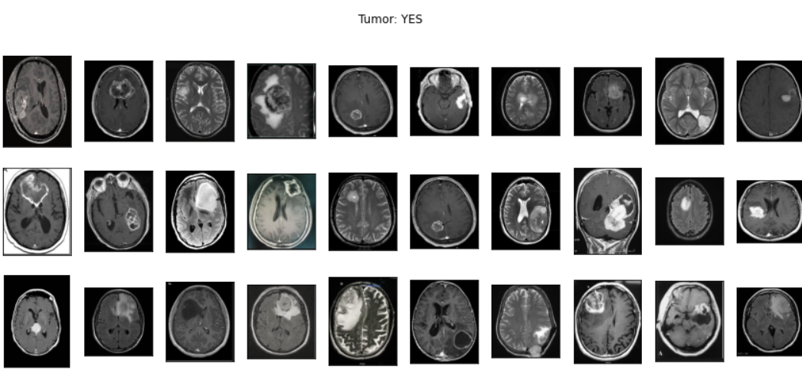

Slide 12
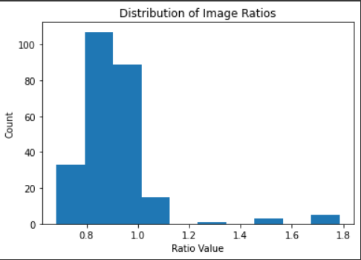
Distribution of images ratios

Slide 13
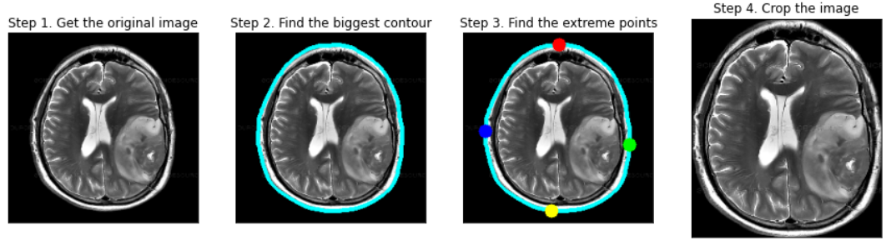
Cropping the Image

Slide 14
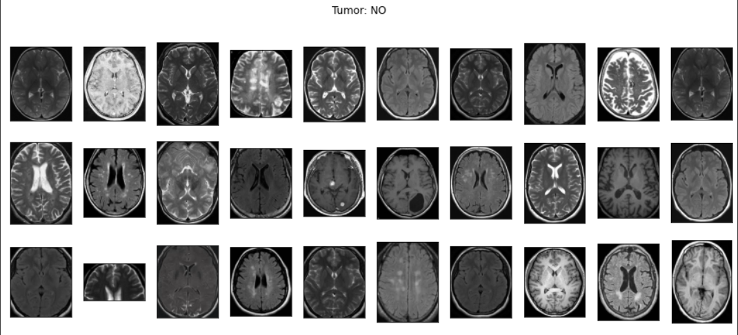

Slide 15
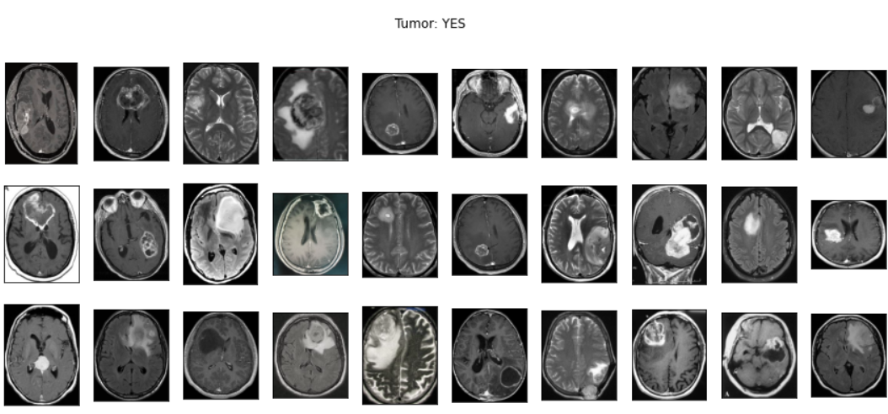

Slide 16
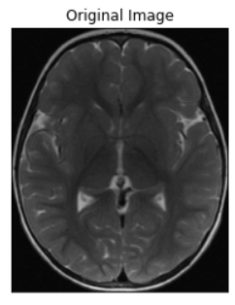
Augment

Slide 17
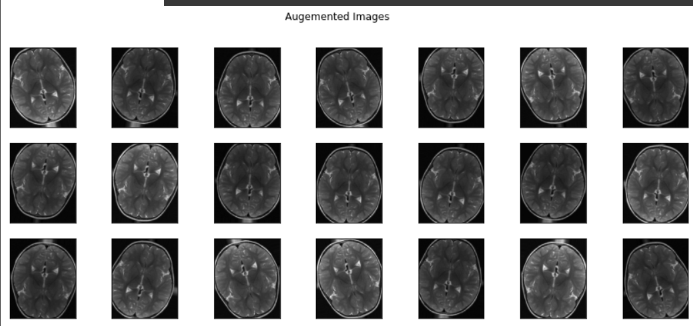

Slide 18
Modelling
BaseLine Model
VGG-16
ResNet50
EfficientNetB0

Slide 19
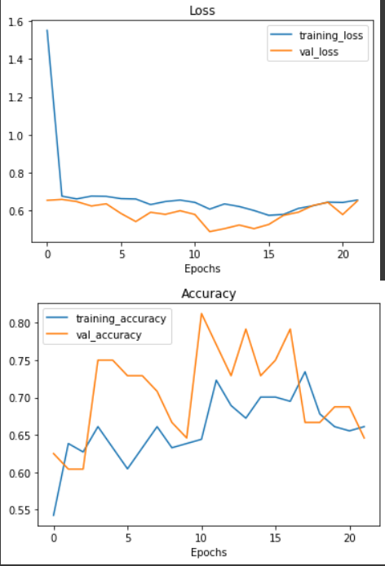
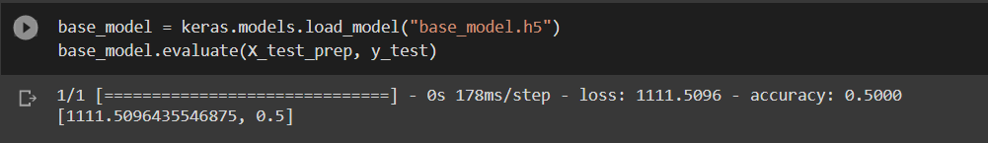
BaseLine Model

Slide 20
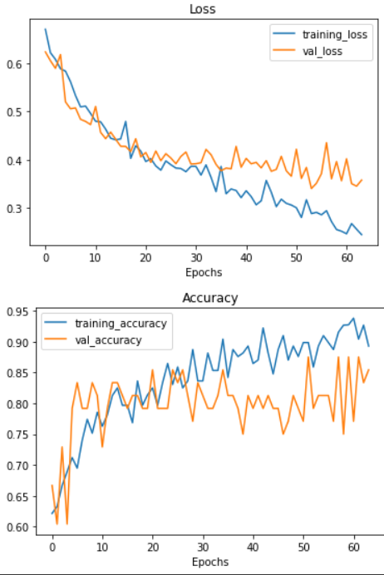
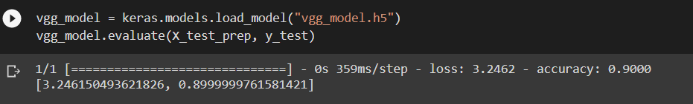
VGG-16

Slide 21
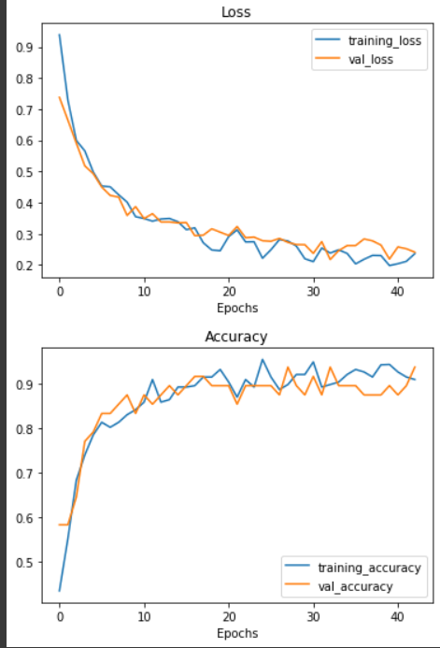
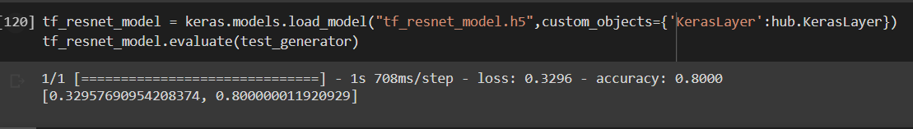
ResNet50

Slide 22
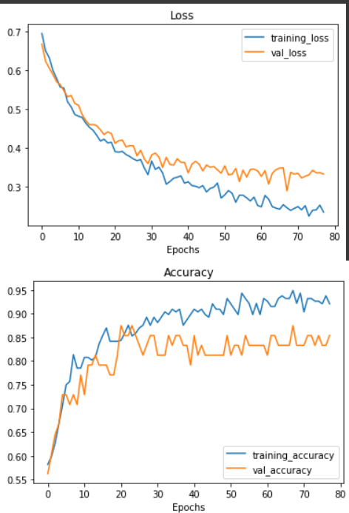
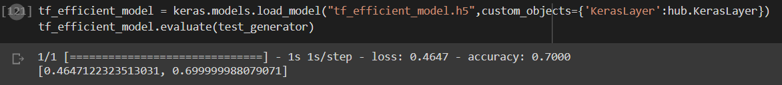
EfficientNetB0

Slide 23

Confusion Matrix VGG-16

Slide 24
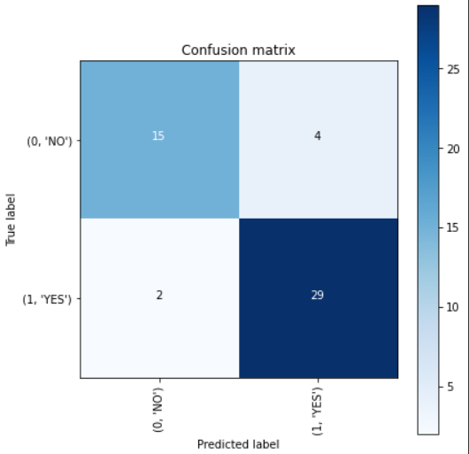

Slide 25
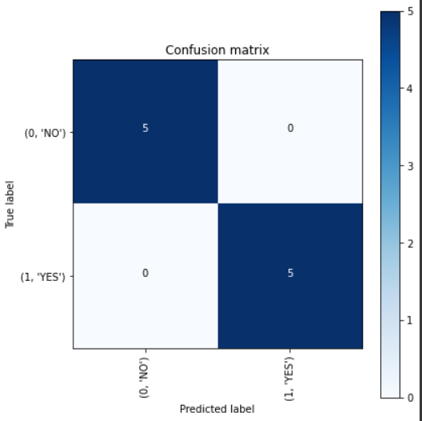

Slide 26
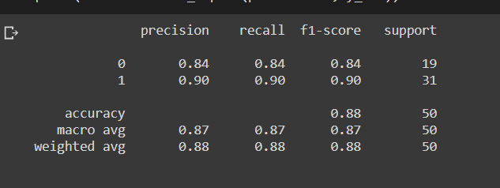
Classification Report : validation data

Slide 27
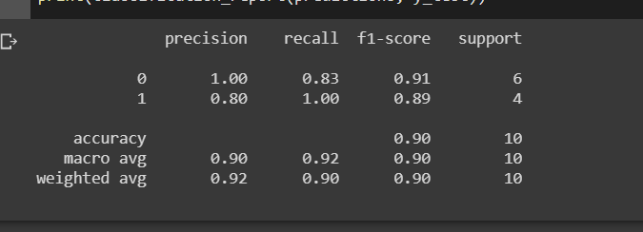
Classification Report: Test Data

Slide 28

Link
https://github.com/Sebercheres/Deep_Learning_Final_Project

Slide 29
Conclusion
The best model was VGG-16 with accuracy of 90% for unseen data

Slide 30

Thank You
See You Next Time

